Slide 1


AI – Vision to Reality Student Workshop January 30, 2026

Slide 2
Agenda
Welcome & Introductions
Review Workshop Objectives
AI Background Info
Configuring the Environment
Lunch / Presidio Presentation (Downstairs in Room 117)
Arduino Setup
Putting It All Together
Wrap Up / What’s Next? – Target to finish the day by ~3pm

Slide 3





Who’s Who
Instructors:
Sponsors & Guests
Jeff Banham
Assistant Professor Cloud Infrastructure
jkbanham@waketech.edu
Jim Matlock
Assistant Professor Computer Programming
jmatlock1@waketech.edu

Slide 4
Workshop Learning Objectives
Technical Skills​
- Python
- Azure
- APIs
- Arduino
- Servos​
“Soft” Skills​
- Meet fellow students
- Collaborate
- Have Fun!

Slide 5

RTP Campus Building 1 Facilities
No food or drink in classroom
Pictures / Vids – posting to social media approval
Lunch – downstairs in Room 117
Materials are owned by Wake Tech
Information you learn can be shared!
If you have to leave before we finish:
Be sure to complete feedback form at end of deck
Be sure to get your swag bag!

Slide 6

Watch for this slide throughout the deck!
We will checkpoint throughout the day to ensure everyone is on the same page?
Help each other out!
CHECKPOINT
If you get behind we’ll wait! If you want to work ahead we might ask you to slow down (and put on your teacher’s assistant hat!)

Slide 7

Links exist throughout the deck to dive more deeply into some of the topics we cover
Great for followup after the workshop!

Slide 8
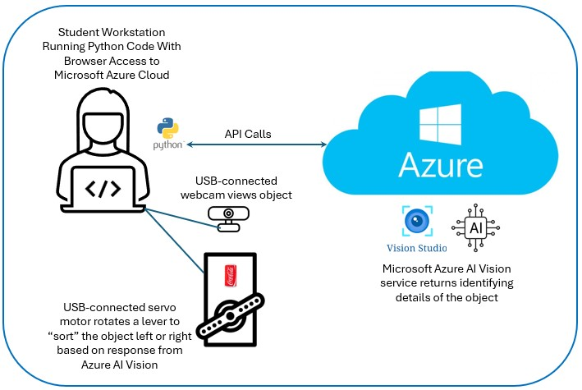
What we’re working towards today!
WORKSHOP PROJECT DEMO
DOWNLOAD THE SLIDES HERE TO FOLLOW ALONG

Slide 9

Artifical Intelligence
What exactly is it?

Slide 10

Intro Discussion: What is AI?
What is first thing you think of?
Discuss positives / negatives

Slide 11
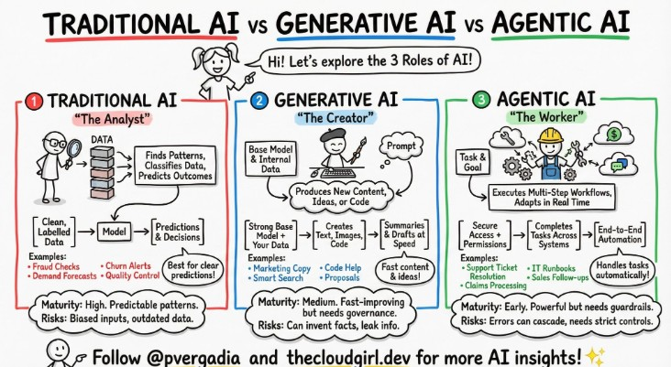
Different Types of AI

Slide 12
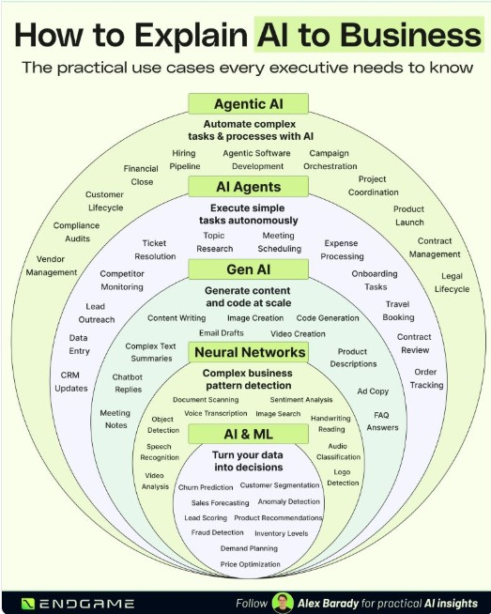
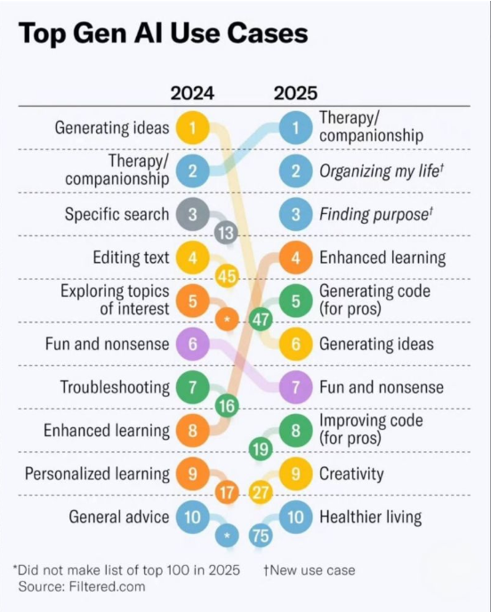

Slide 13
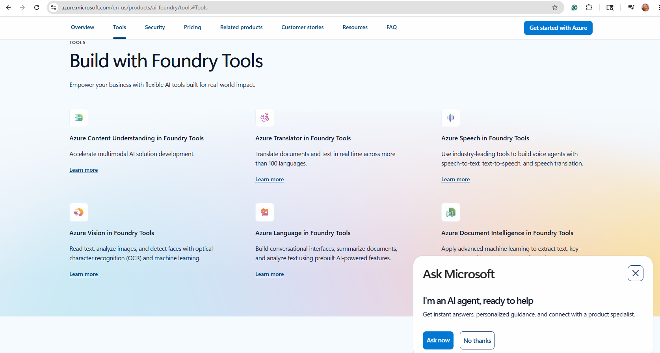
Some of the AI offerings in Microsoft Azure

Slide 14

Environment Setup

Slide 15
What is Visual Studio Code?
Microsoft’s Integrated Development Environment (IDE) tool.
Used by developers working in various coding languages for the following reasons:
Increased Productivity & Efficiency: Automates repetitive tasks, allowing for faster coding and less context switching between different applications.
Smarter Code Editing: Features like syntax highlighting, auto-completion, and error detection help you write correct and readable code more quickly.
Integrated Debugging: Built-in debuggers let you set breakpoints, step through code, and inspect variables to find and fix bugs easily.
Streamlined Project Management: Tools for file management, building, and version control (like Git) keep large projects organized.
Enhanced Code Quality: Real-time feedback and automated testing frameworks help catch mistakes early, improving overall code quality.
Better Collaboration: Integrates with source control systems (like GitHub), making it easier for teams to share and manage code.
Centralized Workflow: Offers a single interface for all development activities, reducing the need to learn and configure multiple standalone tools.
You can download VSCode here (it’s free!): https://code.visualstudio.com/download

Slide 16
Python – One of the most-heavily-used programming languages
Show of hands:
Levels of Python experience? Never Heard of It / Novice / A Little / Guru
Who has taken CSC-121? CSC-122? Other Python or Development Courses?
What is a virtual environment and why do we need it?
A self-contained directory tree that contains its own Python installation (a specific version of the interpreter) and a separate set of installed packages. It acts as an isolated workspace, ensuring that a project's dependencies do not conflict with those of other projects or the global system installation

Slide 17
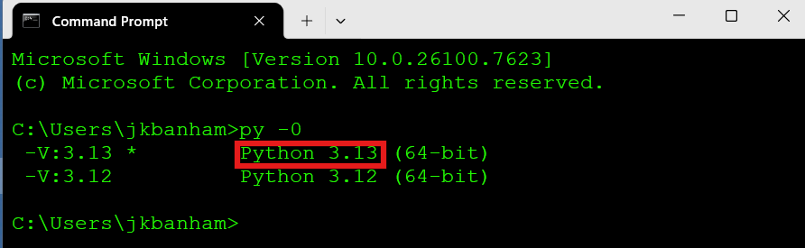
Create A Python Virtual Environment
Check that Python is installed on your workstation:
Open a Windows CLI command window
Type the command py -0 (it’s the number zero) in a command/terminal window
(you should see v3.13.x installed – you may see other versions also)

Slide 18
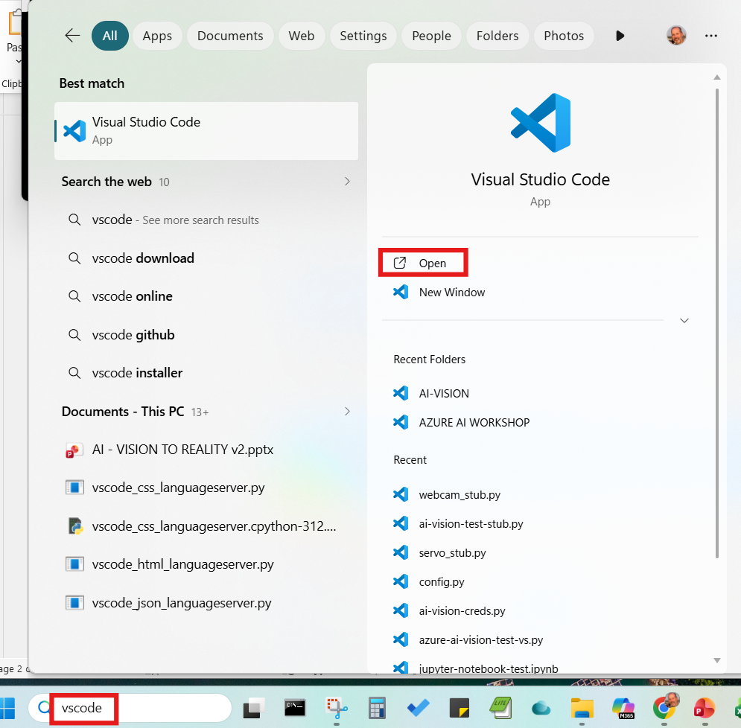
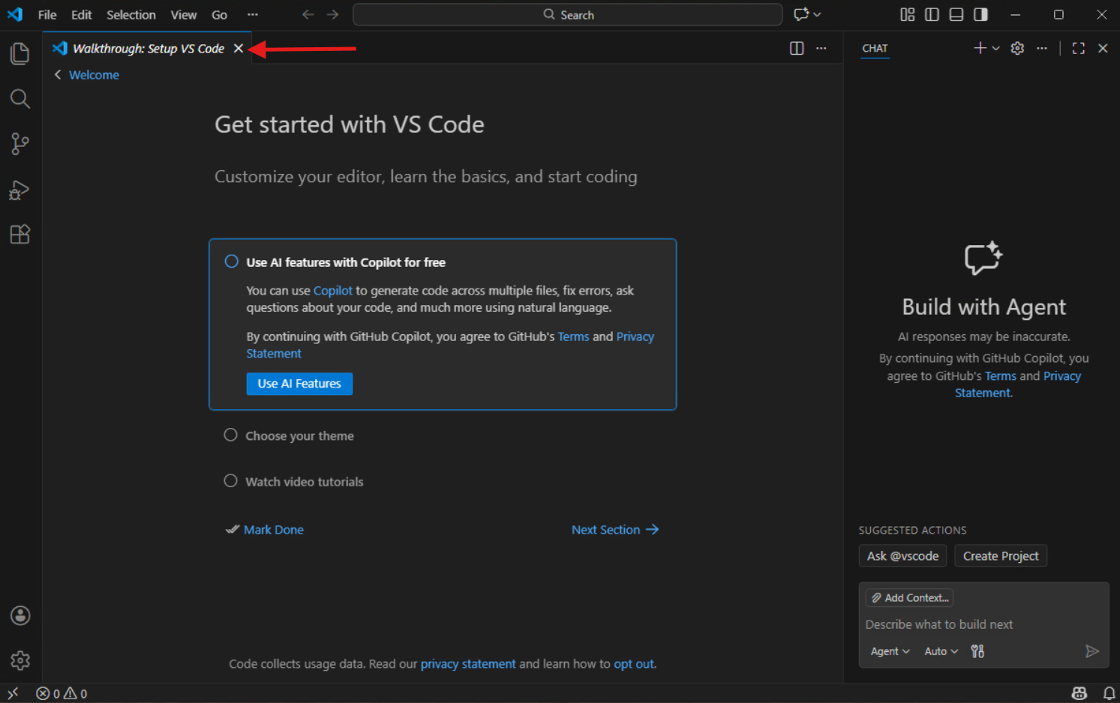
Create Your Python Virtual Environment
2) Launch Microsoft Virtual Studio Code
You can click the ‘X” to close the Walkthrough Setup tab

Slide 19
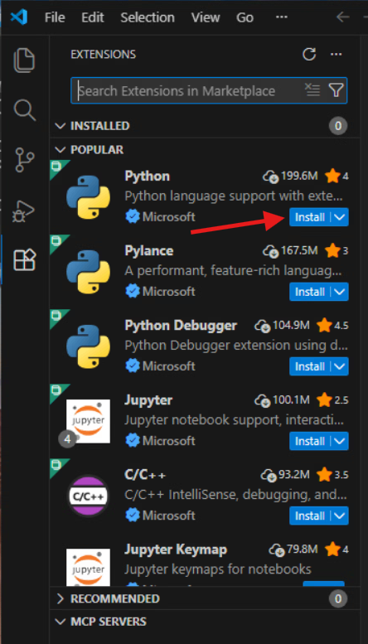
Create A Python Virtual Environment
3) In VSCode, type the CTRL + SHIFT + X keys to bring up the Extensions Window and click the ‘Install’ button for Python. It will take a minute or two to complete the extension installation.

Slide 20
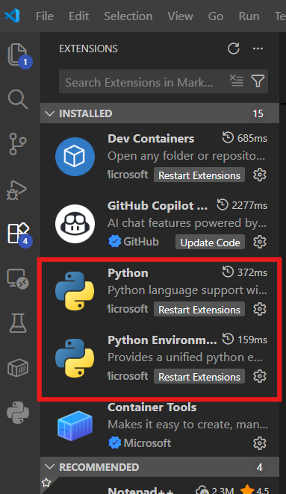
Create A Python Virtual Environment
4) Check that Python is successfully enabled :
You should now see Python in the list under the ‘INSTALLED’ extensions in the left-side panel. (Type CTRL-SHIFT-X again if you need to reopen that panel)

Slide 21
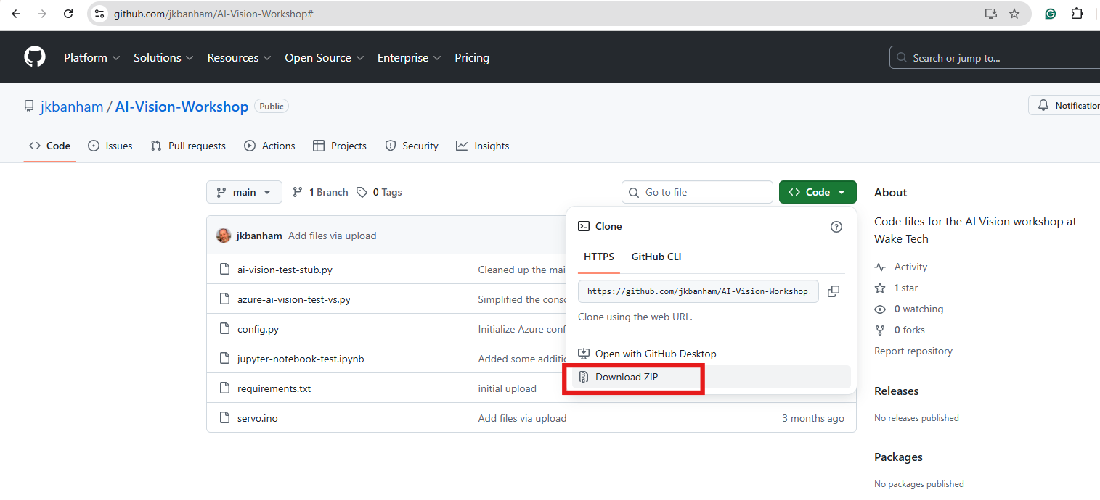
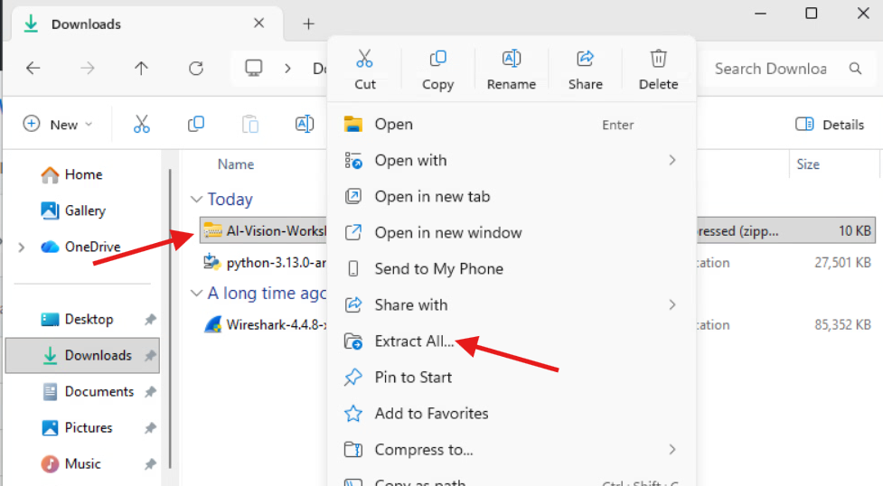
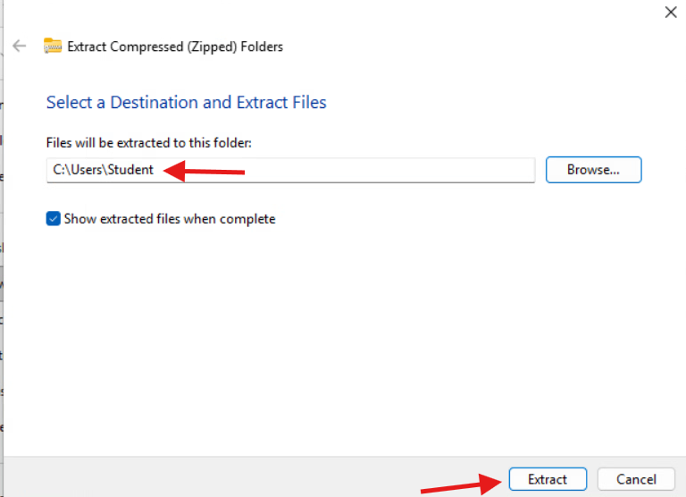
Create A Python Virtual Environment
5) Open a browser and navigate to:
https://github.com/jkbanham/AI-Vision-Workshop
Click the green Code button and select the ‘Download ZIP’ menu choice – the zip file will download into your C:\Users\<your-username>\Downloads folder
Open File Explorer, navigate to your Downloads folder and right-click on the AI-Vision-Workshop-main zip file. Select ‘Extract All’ from the menu
Click the Browse button to select your user folder (C:\Users\<your-username>) as the destination and click the ‘Extract’ button

Slide 22
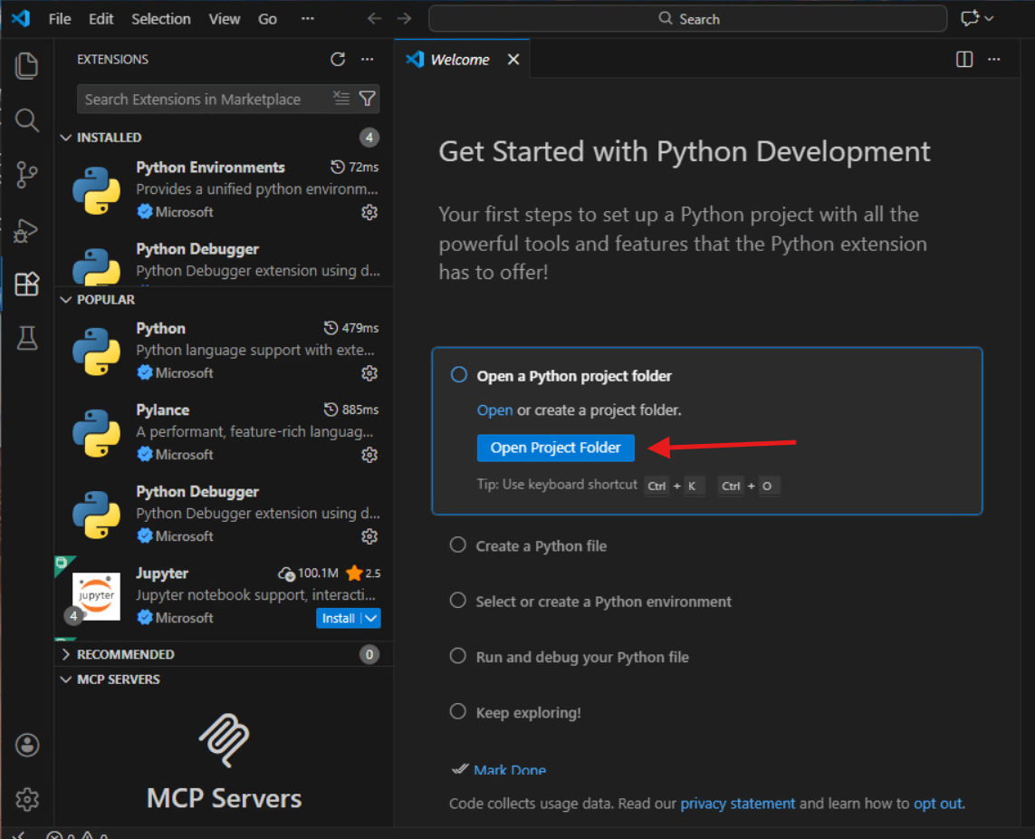
Create A Python Virtual Environment
6) Back in VS Code, click on the ‘Open Project Folder’ button in the Get Started with Python Development window
(Select Help->Welcome if this window isn’t currently showing for you and then click on the ‘Open Folder’ link)

Slide 23
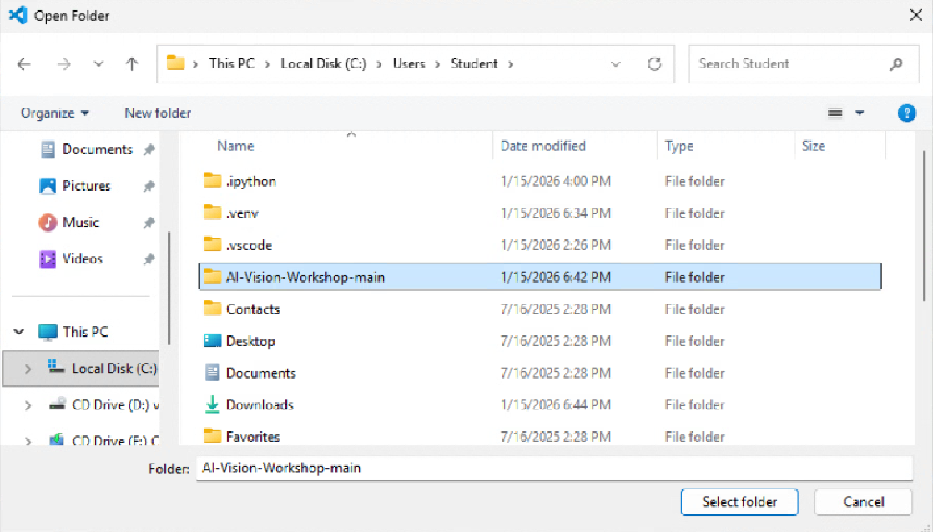
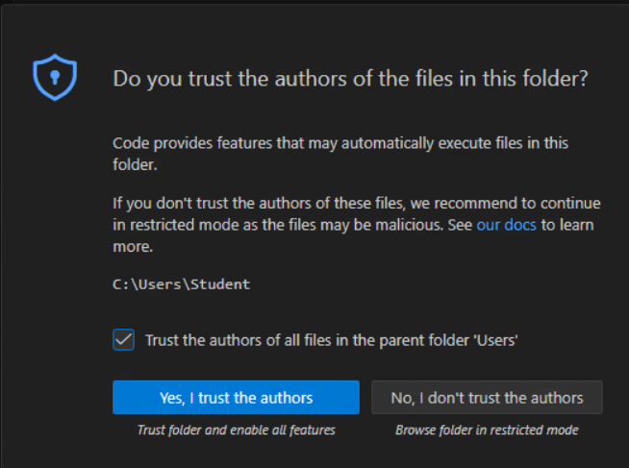
Create A Python Virtual Environment
7) Select the C:\Users\<your-username>\AI-Vision-Workshop-main folder and then click the ‘Trust the authors of all files in the parent folder…’ and click the ‘Yes, I trust the authors’ button

Slide 24
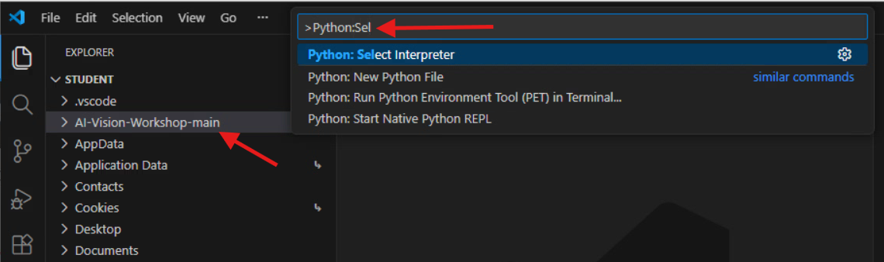
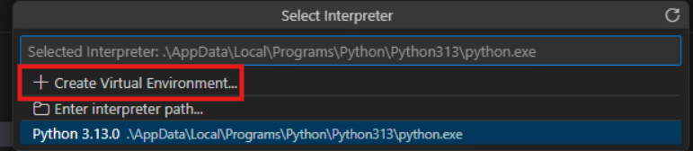
Create A Python Virtual Environment
8) Set the Python Interpreter in VSCode
Back in VSCode, click the ‘AI-Vision-Workshop-main’ folder in the left-side EXPLORER pane.
Type CTRL + SHIFT + P to open the command palette and type Python:Select Interpreter and click it
Click the + Create Virtual Environment option

Slide 25
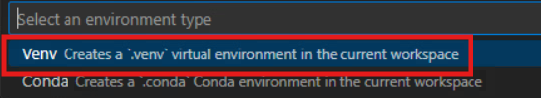
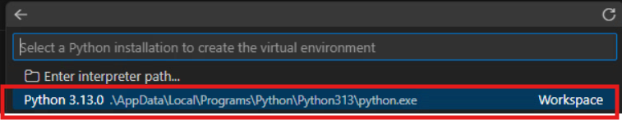
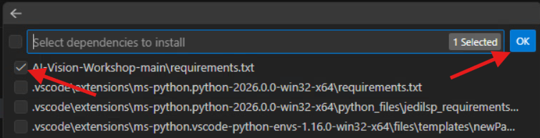
Create Your Python Virtual Environment
Click the ‘Venv Creates a…’ choice
Choose the Python 3.13.x interpreter and click it (your screen might look different – it probably shows version 3.13.5)
Click the check box next to the AI-Vision-Workshop-main\requirements.txt file and then click the OK button
The needed python modules will now be loaded into your environment and you will have a functional virtual python environment created in your project folder – be patient - this can take ~3-4 minutes to complete

Slide 26
CHECKPOINT

Slide 27
Microsoft Azure

Slide 28

What is Microsoft Azure?
Microsoft’s Cloud-based Product & Solutions Suite
Access here: https://portal.azure.com
Some key concepts to understand:
What is a subscription? A billing context
What is a resource group? An organizational context
What is a resource? An implementation of a product or service (ie a virtual machine)
Take a look at all Azure offerings here:
https://azure.microsoft.com/en-us/products

Slide 29
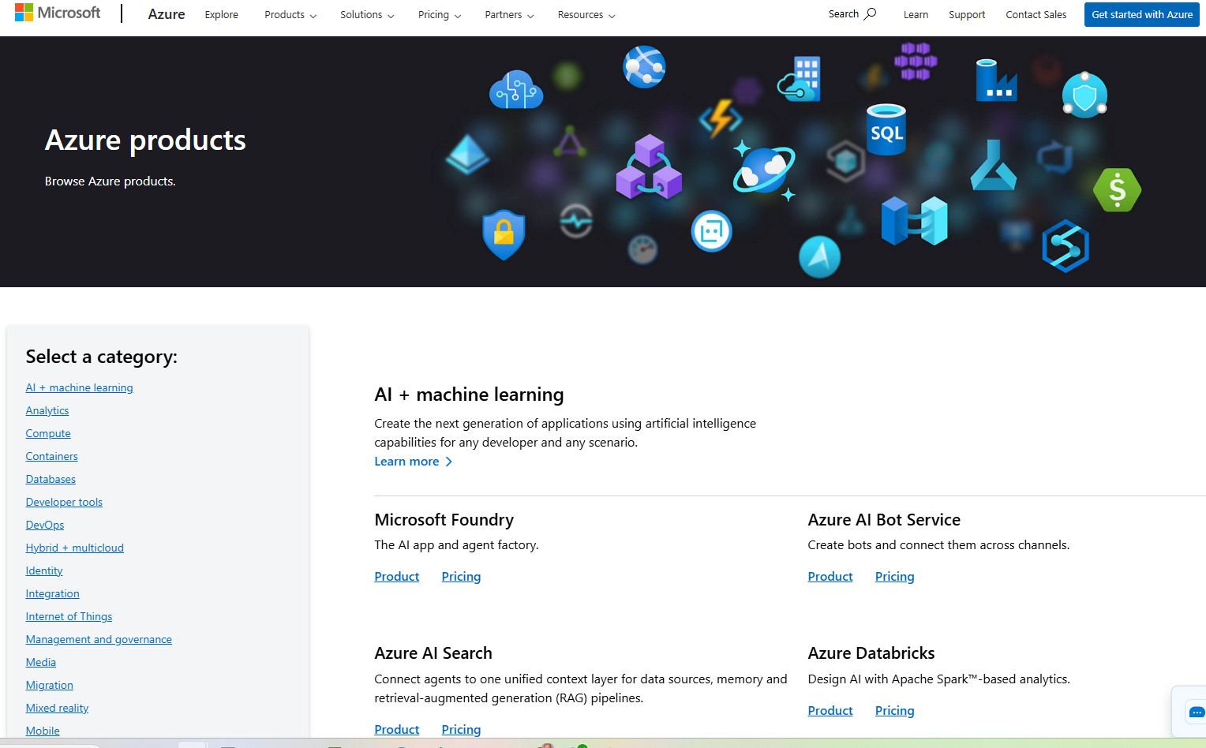
Show all Azure AI products??
https://azure.microsoft.com/en-us/products

Slide 30
What is an API?
Application Programming Interface
If you can’t have a human manually interacting with a system (keyboard, mouse, etc) you can use an API
Enables, machine-to-machine interaction
Security is important / challenging!
We will use API’s so our Python program code can utilize the resources we build in the Microsoft Azure environment

Slide 31


Azure Resources We Will Build Today
Computer Vision – Part of Microsoft’s suite of AI tools and services – it take an image file as input and can analyze it to return many different results such as whether there is text in the image (and what it says), if there are objects in the image (and what they are), if there are people/faces in the image (and specifically where they are in the image), etc.
Storage Blob Container – an internet-accessible (ie public cloud) storage resource where we can easily upload and store image files. Blob storage (Blob storage (Binary Large Object storage) is a highly scalable, cost-effective cloud solution for storing massive amounts of unstructured data, like text, images, videos, audio files, and backups, that doesn't fit traditional database structures.

Slide 32
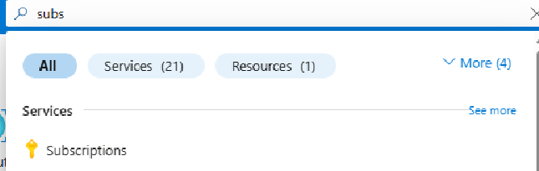
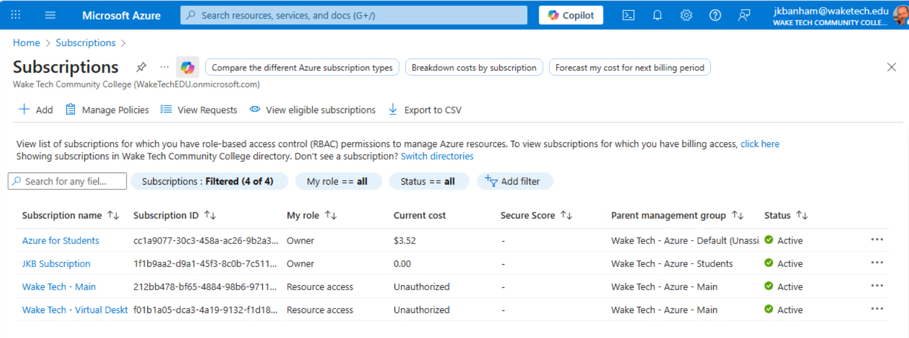
Configure Microsoft Azure Resources
Login to the Microsoft Azure Portal (portal.azure.com) with your Wake Tech key account
Type ‘subsc’ in the search bar at the top of the screen and then click the ‘Subscriptions’ tool
Ensure that you have an active ‘Azure for Students’ subscription in your list

Slide 33
Create an Azure Computer Vision Resource

Slide 34
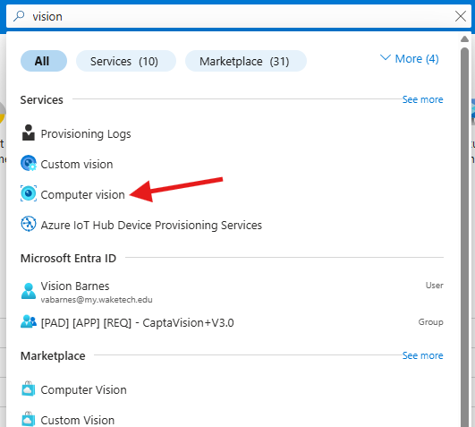
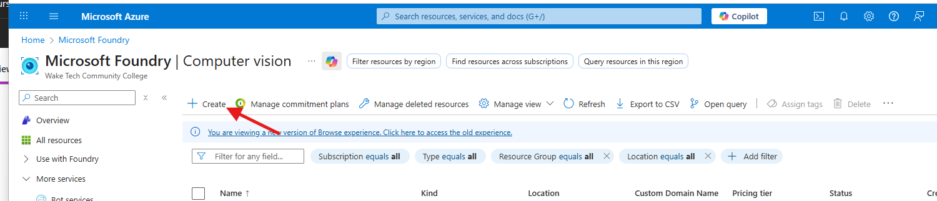
Create an Azure Computer Vision Resource
Log in to your Azure portal account (portal.azure.com)
In the search bar at the top of the screen type ‘vision’
Select the ‘Computer Vision’ resource
The Computer Vision resource page will open. Click the ‘+ Create’ button

Slide 35
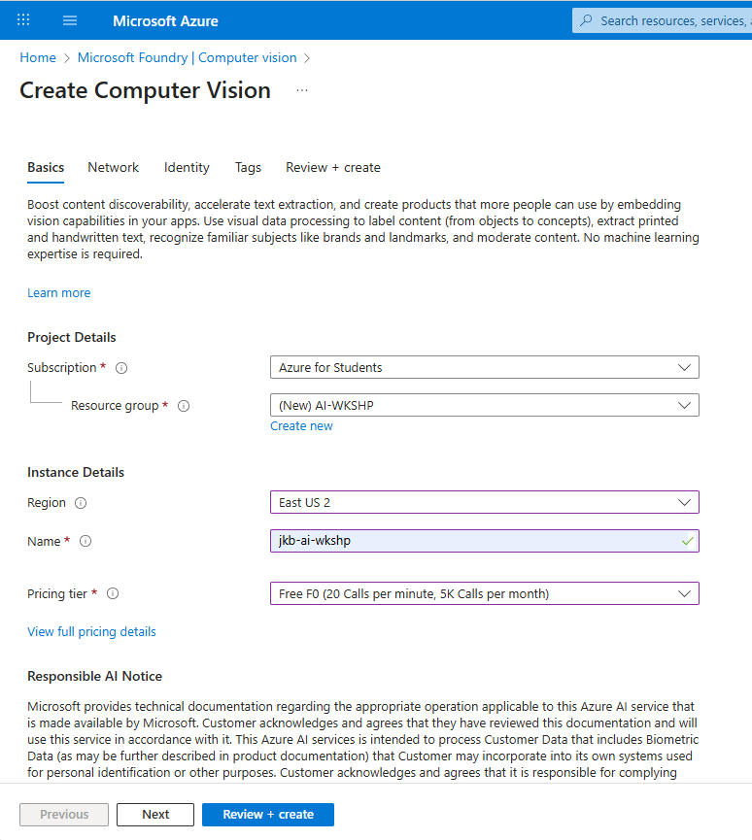
Create an Azure Computer Vision Resource
Complete the config screen as follows:
Subscription: Select your student subscription
Resource group: Click the ‘Create new’ link and create a new Resource group named “AI-WKSHP’
Region: Leave the default choice
Name: Use your initials followed by ‘-ai-wkshp’ For example. I named mine jkb-ai-wkshp
Pricing Tier: Select the Free F0 tier
Scroll down and click the terms acknowledgement box at the bottom and then click the ‘Review + create’ button

Slide 36
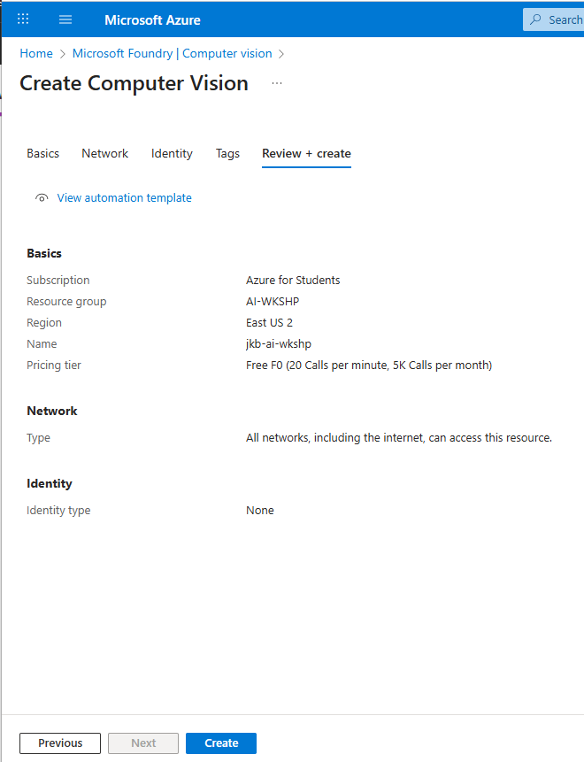
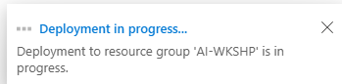
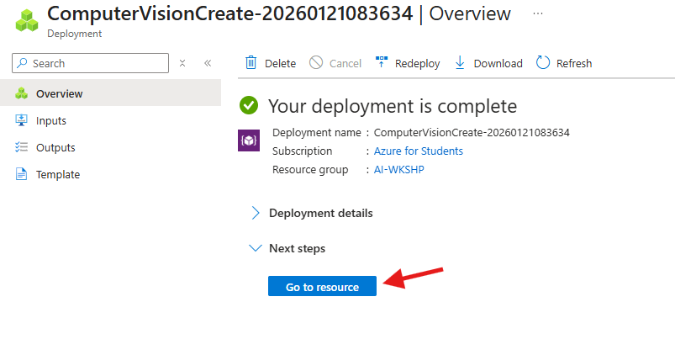
Create an Azure Computer Vision Resource
The config will validate and then you can click the ‘Create’ button.
You will see a ‘Deployment in progress…’ notice for a few moments and then your new resource will be ready.
When the deployment is complete, click on the ‘Go to resource’ button

Slide 37
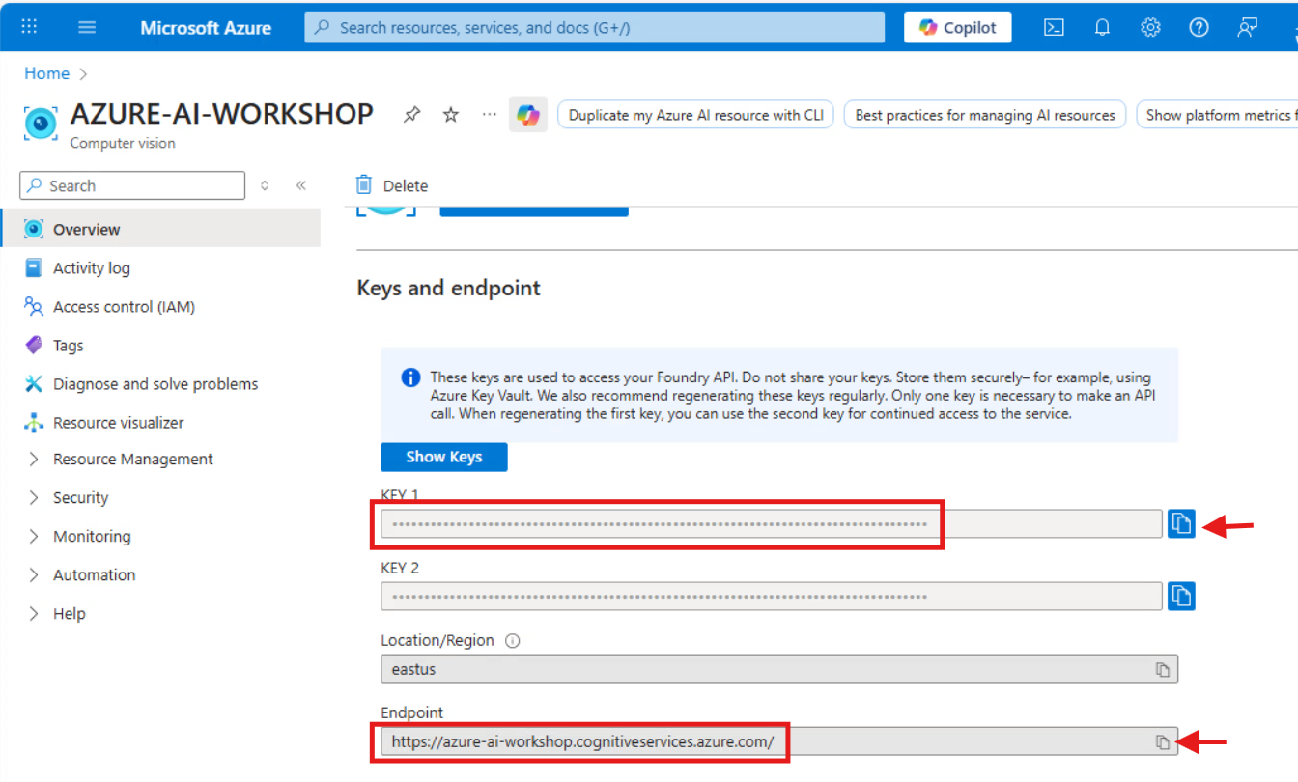
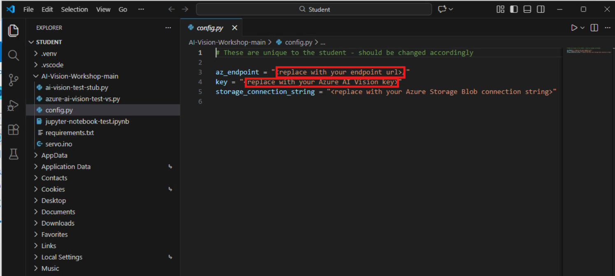
Create an Azure Computer Vision Resource
Click on the new resource name to open its properties
Scroll down and note the values for KEY 1 and Endpoint. We will need to copy these values and paste them into the config.py file (in VSCode)

Slide 38
CHECKPOINT

Slide 39
Create an Azure Storage Account & Storage Blob Container

Slide 40
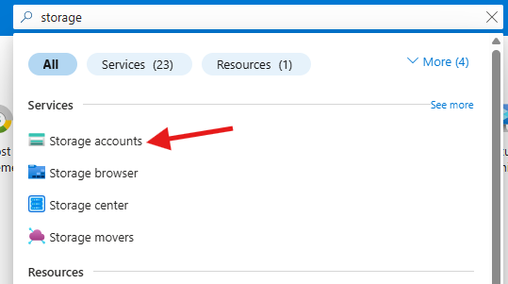
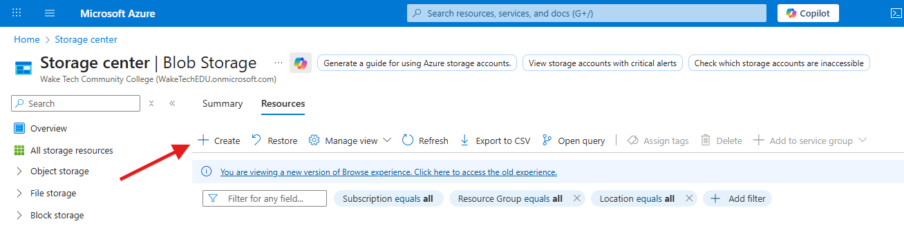
Create an Azure Storage Account
In the Azure portal, type ‘storage’ in the search bar at the top of the screen
Select the ‘Storage accounts’ resource
The Storage center page will open. Click the ‘+ Create’ button

Slide 41
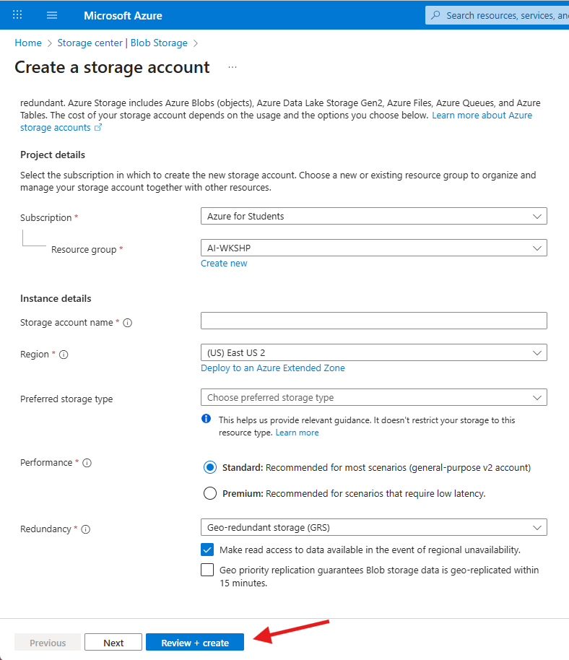
Create an Azure Storage Account
Complete the config screen as follows:
Subscription: Select your student subscription
Resource group: Select the “AI-WKSHP’ resource group that you previously created
Storage account name: Use your initials followed by ‘aiwkshp’ For example. I named mine jkbaiwkshp
Region: Leave the default choice
Preferred storage type: Select ‘Azure Blob Storage or…”
Performance: Leave as Standard
Redundancy: Leave as Geo-redundant
Scroll down and click the ‘Review + create’ button

Slide 42
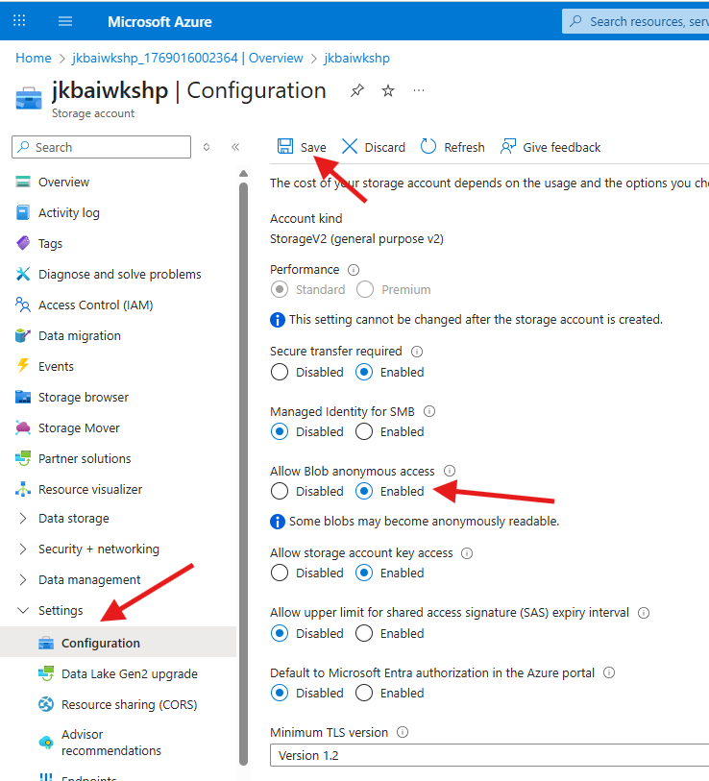
Create an Azure Storage Account
Once the settings validate you can click the ‘Create’ button
You will see a ‘Deployment in progress…’ notice for a few moments and then your new resource will be ready.
When the deployment is complete, click on the ‘Go to resource’ button
In the left-hand pane, expand the ‘Settings’ menu and select ‘Configuration’
Change the ‘Allow Blob anonymous access’ setting to ‘Enabled’ and then click the ‘Save’ button at the top of the screen

Slide 43
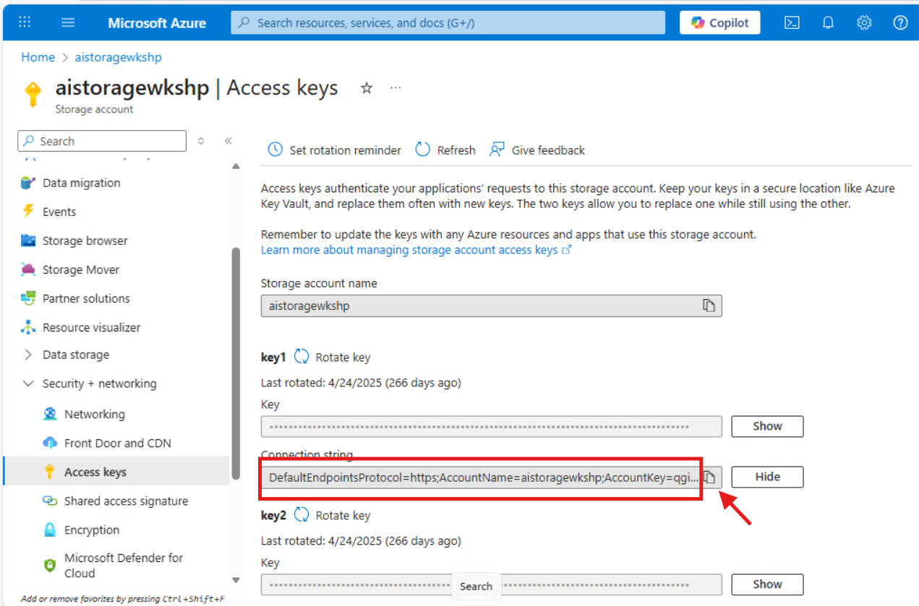
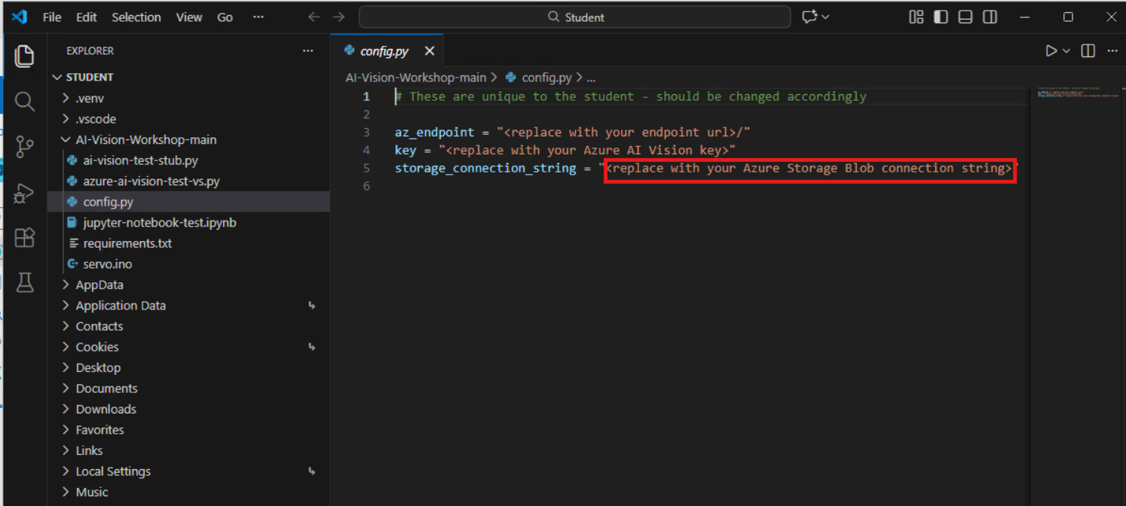
Create an Azure Storage Account
In the left-hand pane, expand the ‘Security + networking’ menu and select ‘Access keys’
Scroll down and note the value of the Connection string. We will need to copy this value into the config.py file (in VSCode)

Slide 44
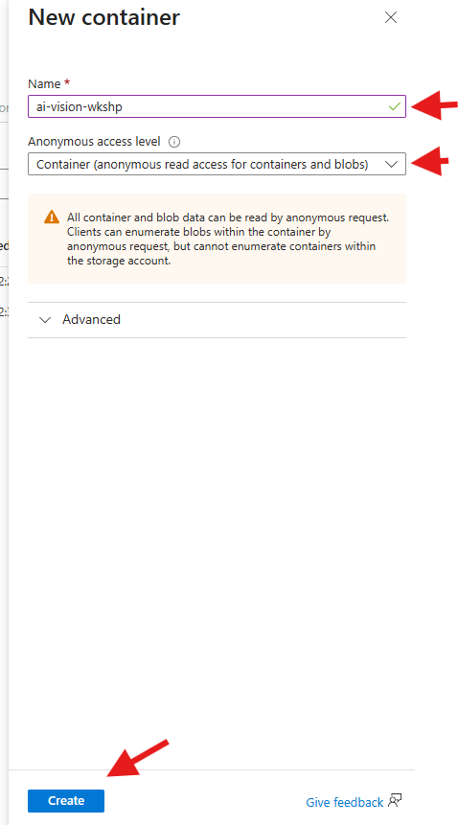
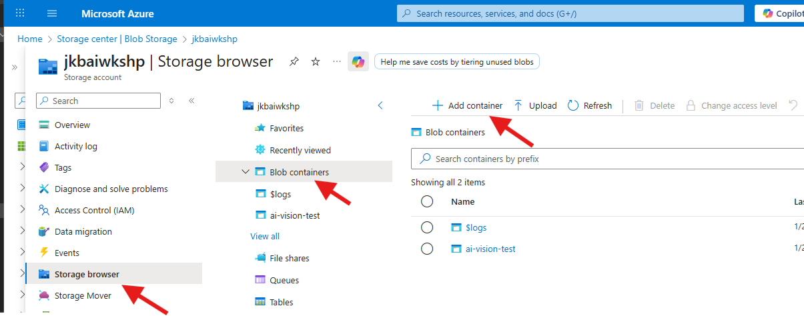
Create an Azure Storage Blob Container Resource
In the left-hand pane, click the ‘Storage browser’ then click ‘Blob containers’ and then click ‘+ Add container’
In the ‘New container’ panel, name the container ai-vision-wkshp and set the Anonymous access level to ‘Container (anonymous read access…’ Then click Create at the bottom of the pane

Slide 45
CHECKPOINT

Slide 46
NO PHONE
HAS A PHONE
Before lunch – each student can tweak this and print it to 306 break room printer

Slide 47

LUNCH BREAK
Thank you to our sponsor Presidio

Slide 48
Jupyter Notebook

Slide 49

What is a Jupyter Notebook?
A Jupyter Notebook is an open-source, web-based interactive environment for creating and sharing documents containing live code, equations, visualizations, and narrative text, popular in data science for its ability to combine code execution (Python, R, Julia, etc.) with rich output in a single, shareable .ipynb file. It's like a digital lab notebook, allowing users to explain their analysis step-by-step, run code in "cells," see results immediately (charts, tables), and document the process, making it great for research, teaching, and reporting

Slide 50
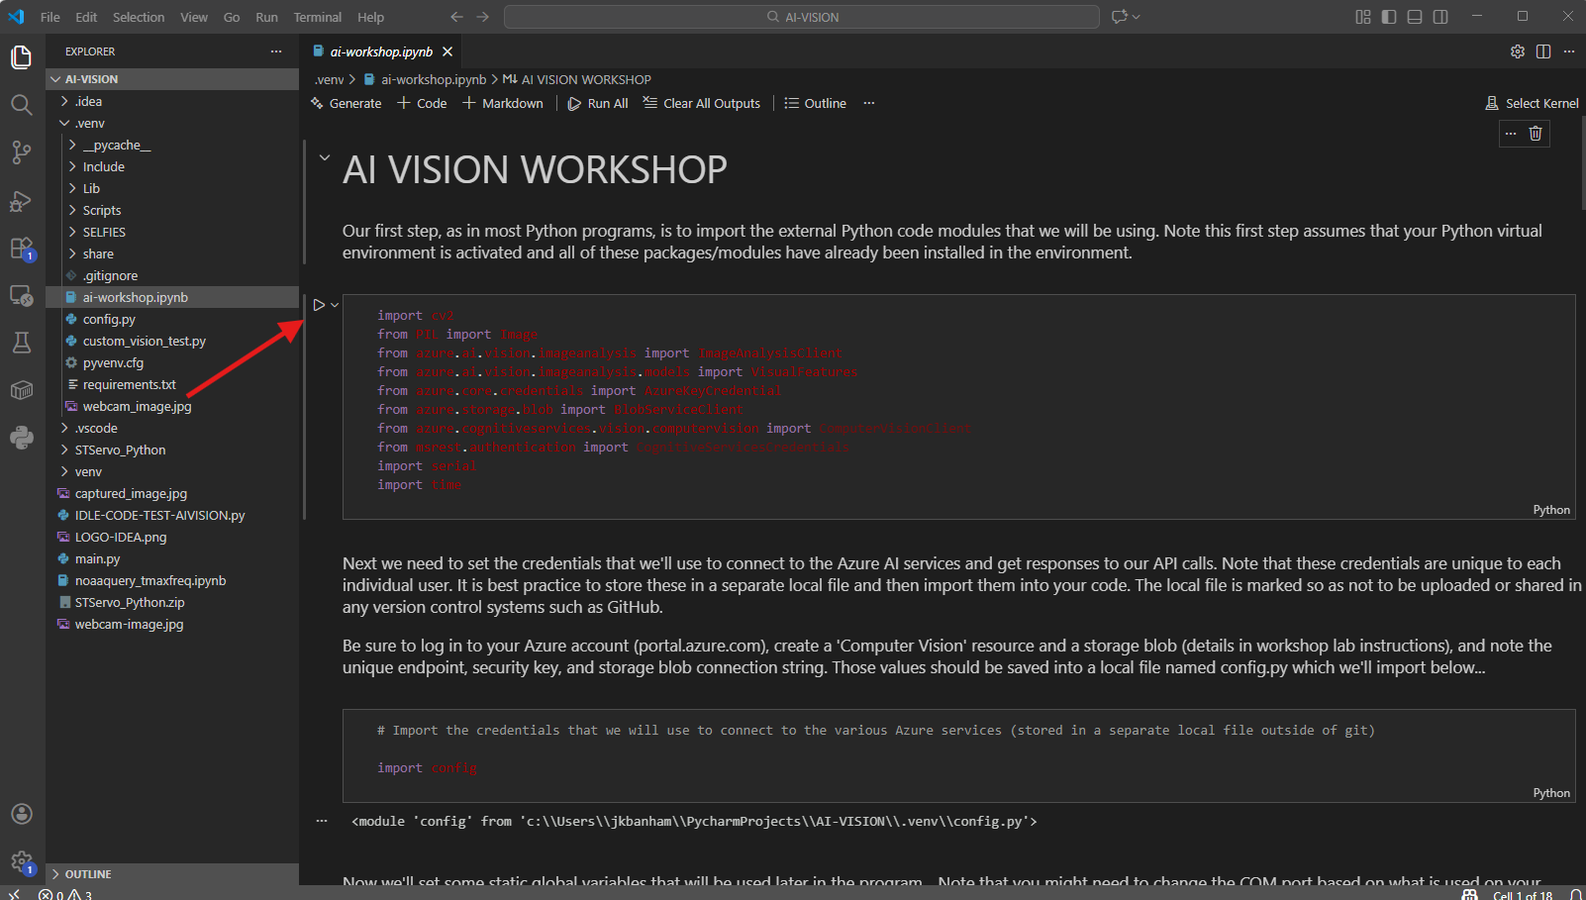
Jupyter Notebook
In VSCode, open the ai-workshop.ipynb file
Click the run arrow icon in the upper left corner of the first notebook cell
See the next slide for details on what happens during the first initial run of a Jupyter notebook cell in VSCode

Slide 51
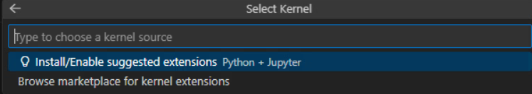
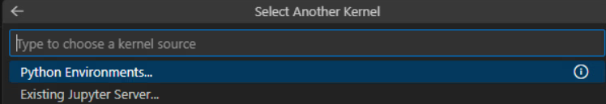
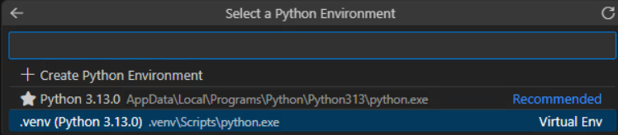
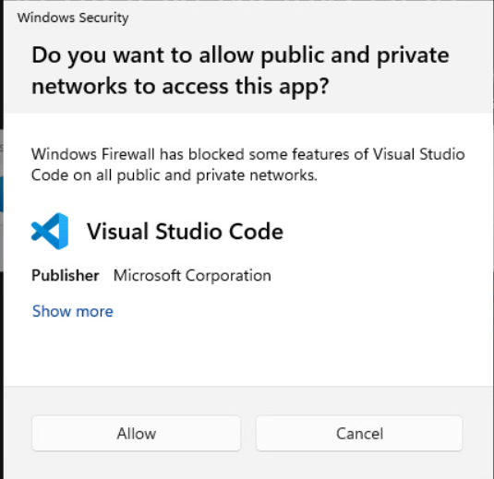
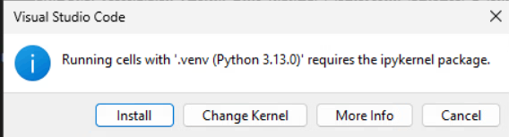
Jupyter Notebook – Initial Run
In the ‘Select Kernel’ dialog box that appears when you execute the first cell in the notebook, click the ‘Install/Enable suggested extensions’ choice
In the next ‘Select Another Kernel’ window, click ‘Python Environments’
In the next ‘Select a Python Environment’ window, click .venv (Python 3.13.x) .venv\Scripts\python.exe
When the ‘Do you want to allow public and private networks…’ window appears, click ‘Cancel’
Finally, click the ‘Install’ choice on the ‘Running cells…’ dialog window
Jupyter Notebook cells will now be enabled in VSCode (if it doesn’t work, close and reopen VSCode)

Slide 52
CHECKPOINT

Slide 53
Jupyter Notebook – Stepping Thru The Code Live Demo
Load external code modules
Define / Load private credentials / keys / etc
Set static variables
Load re-usable functions
Capture an image from the attached webcam
Upload the image into the Azure environment
Use Azure AI tools to analyze the image
Rotate the Arduino-attached servo motor based on the image analysis result (we’ll attach and configure this next!)

Slide 54
Arduino & Servo Motor

Slide 55
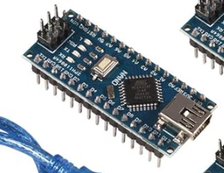
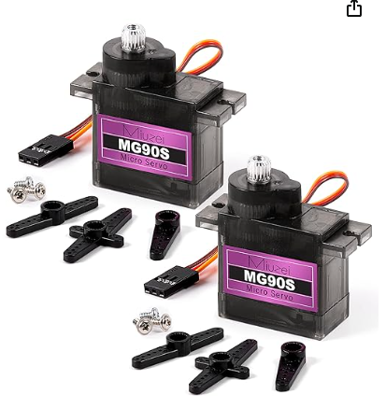
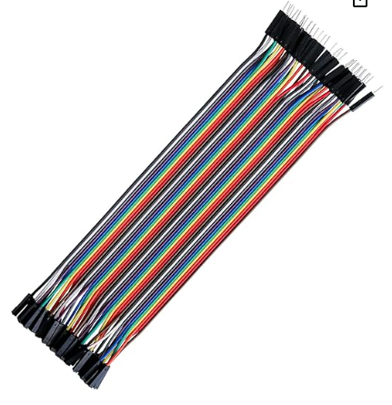
What is a microcontroller?
What is an Arduino board?
What is a servo motor?

Slide 56
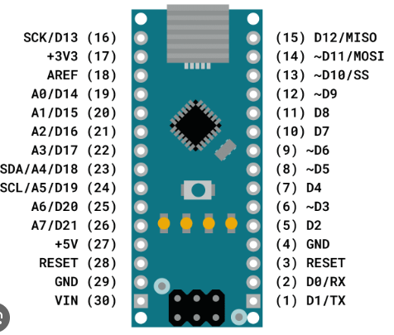

Arduino Board – Servo Motor Connection:
Servo Brown Wire (Ground) – Arduino Pin 29 (GND)
Servo Red Wire (Power) – Arduino Pin 27(+5v)
Servo Yellow Wire (Signal) – Arduino Pin 12 (D9)
Arduino Blue USB-Mini cable connects to PC (note that code has already been flashed onto the Arduino board)
Top of Board View
Bottom of Board View

Slide 57




After you plug the Arduino board into your computer:
Open Device Manager – you can click ‘OK’ to the ‘Standard User’ warning dialog
Scroll down and expand the ‘Ports (COM & LPT)’ section – not what port number your Arduino has been assigned to
In VSCode, we need to ensure that the COM port setting in the code matches the actual connection

Slide 58



The Final Touches!
Popsicle stick screws into servo motor – this will be our rotating arm – you can decorate it with an arrow (or be creative!)
Cut a slit in a piece of foam and wedge the servo into it to provide a stable platform
Print out your left-right sorting page
Use the 2nd to last cell in the Jupyter Notebook to test your setup and calibrate the servo:
The motor housing (where the popsicle stick is connected) is the ‘front’ of the motor
The servo is limited to movement between 0 and 180 degrees. If we set the popsicle stick straight up and the motor at 90 degrees then we can move left (0 degrees) and right (180 degrees)

Slide 59
CHECKPOINT

Slide 60


Clean Up
The Azure resources that you have created today should consume minimal resource cost per day against your free subscription value. You can view the daily costs in the Cost management section of the Azure Portal.
You will receive an invoice via email each month (but costs will show as $0.00)
Note that best practice is simply to delete the resources that you created if you do not plan to continue using them.

Slide 61

Futures – What to learn next?
A very cool project where the AI LLM is running on the local machine (no cloud/internet required!)
SmolVLM real-time camera demo: https://www.reddit.com/r/LocalLLaMA/comments/1klx9q2/realtime_webcam_demo_with_smolvlm_using_llamacpp/
Project code & details here: https://github.com/ngxson/smolvlm-realtime-webcam
If you are a Wake County Public Libraries card holder (and it’s free to get one if not!) Check out this free access to Udemy program
Once you set up your access, log in to Udemy and look for the course titled ‘Microsoft Applied Skills: Build an Azure AI Vision solution’ to review what we did today and to learn more about training a custom vision model!

Slide 62

Please take a moment to complete this short feedback form – it will help us to improve the workshop for future students!
https://forms.office.com/r/B2Sef21pPg

Slide 63


Thank you
This material is the property of Wake Tech Community College and should not be reproduced or shared without prior written permission.
Please contact Jeff Banham (jkbanham@waketech.edu) for more info.
This project and workshop was funded by the Wake Tech Threaded AI Project Initiative

